Slide 1
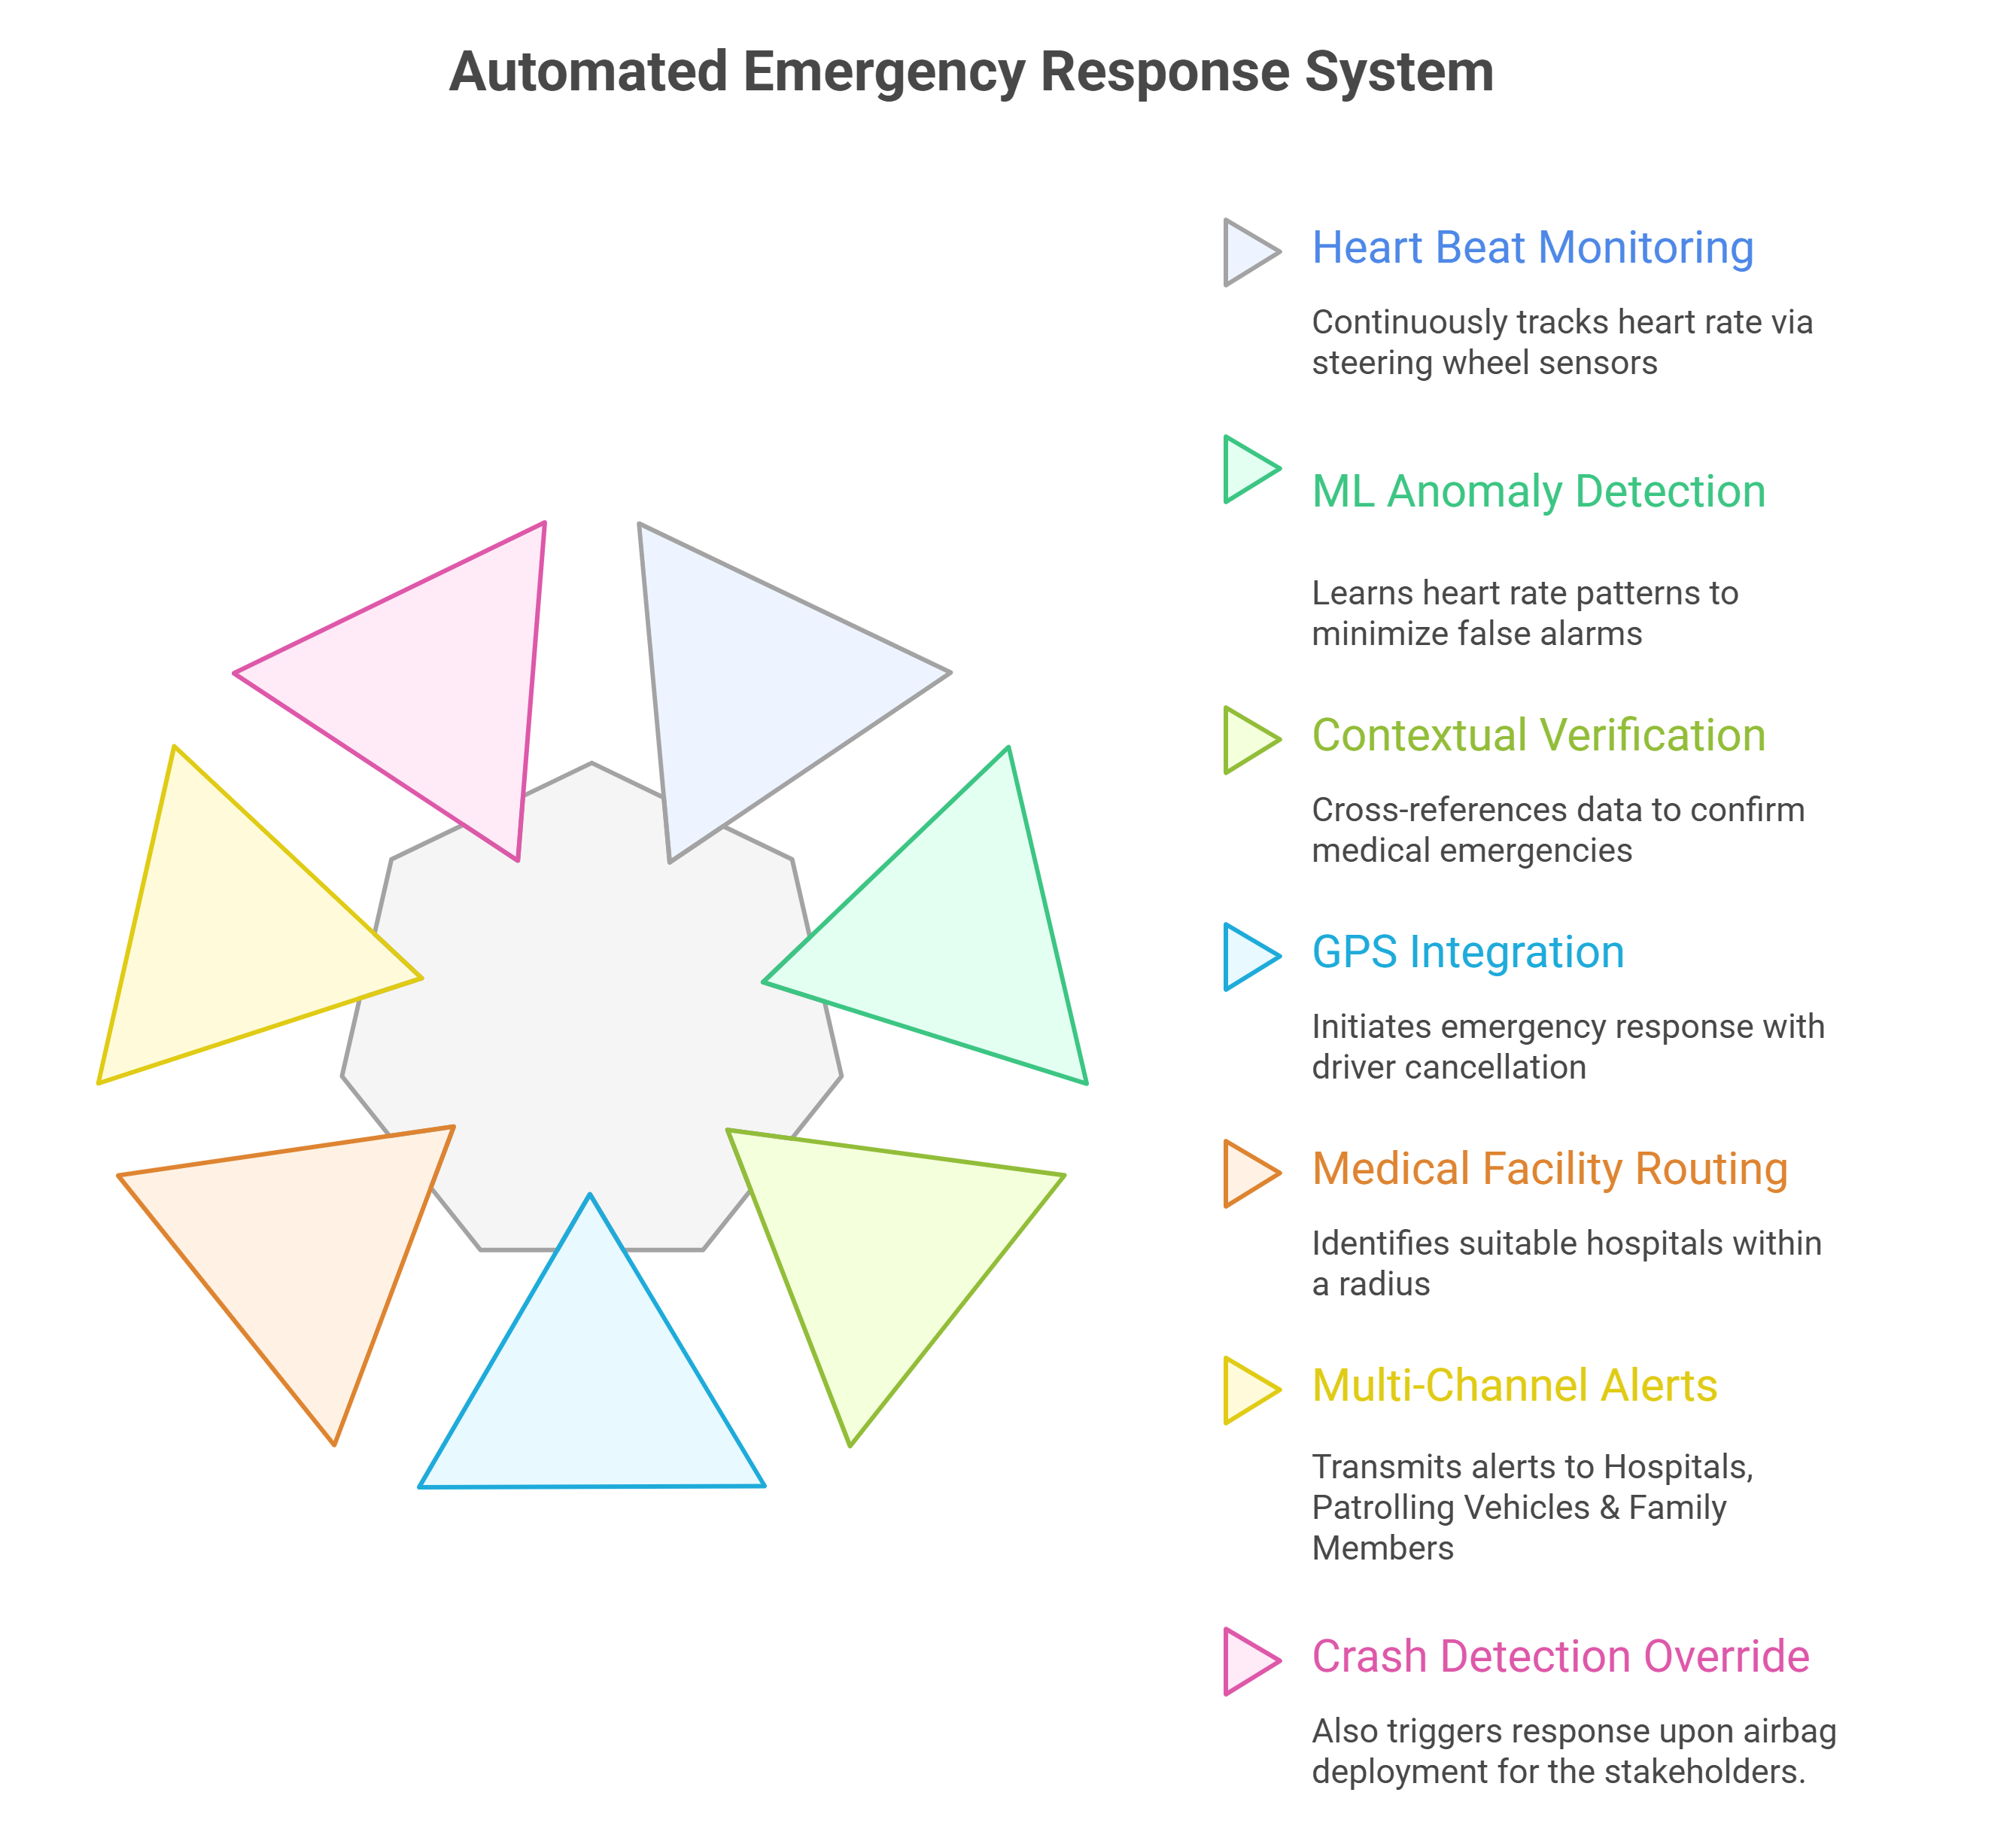
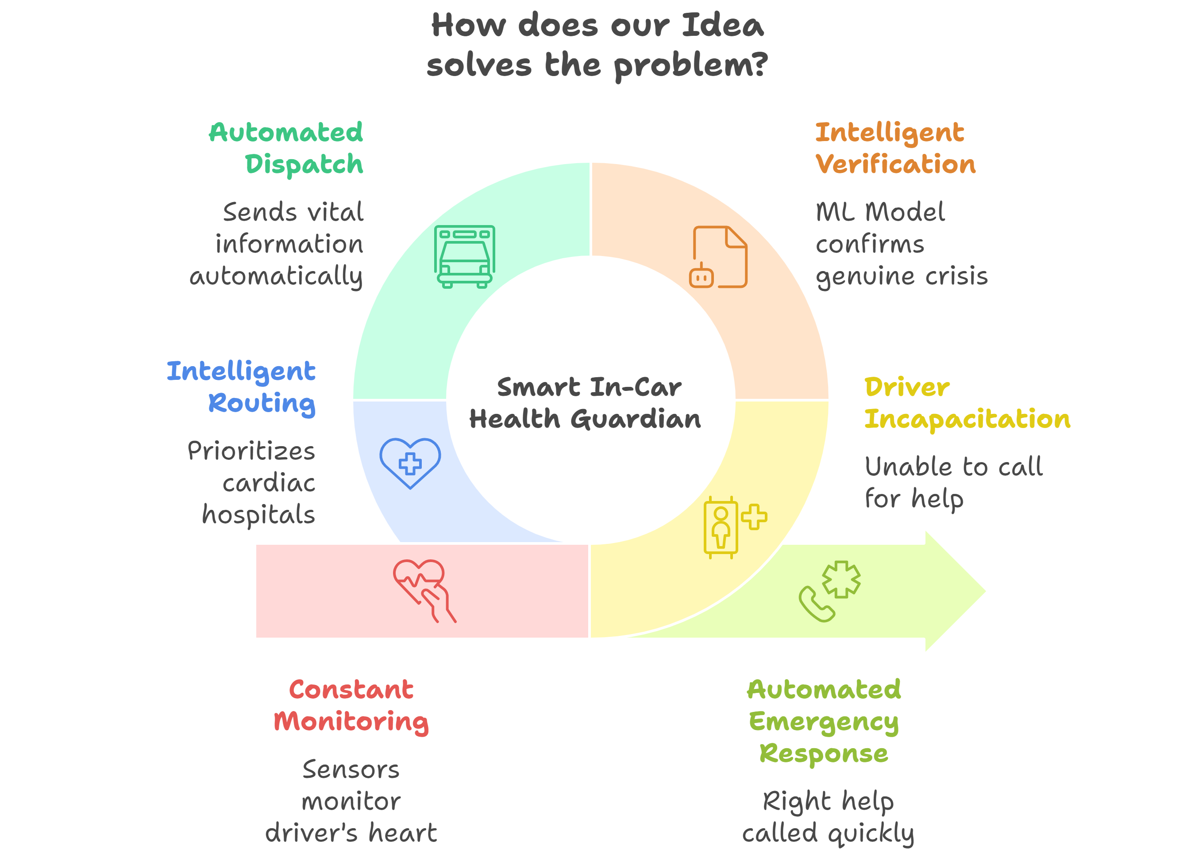
Smart In-Car Health Guardian
PRAVARTAKA

Slide 2
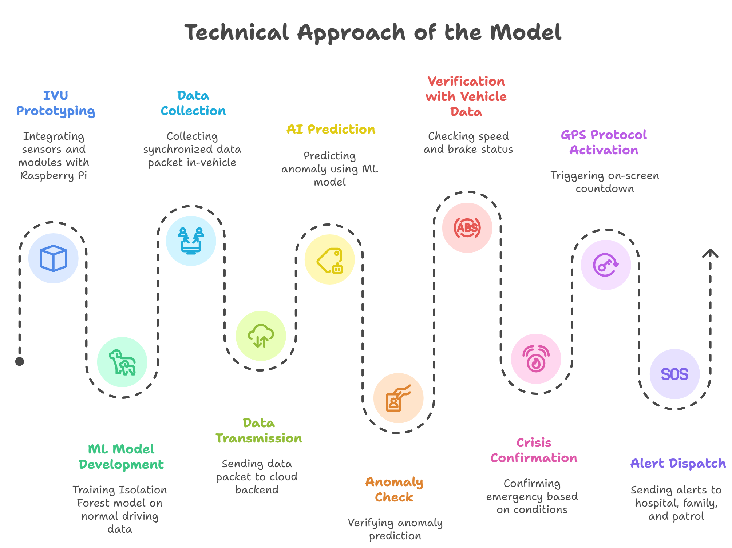

TECHNICAL APPROACH
PRAVARTAKA
This system uses a Raspberry Pi 4 to process real-time heart rate data from a TCRTXXX sensor, applying LSTM Autoencoder and Decision Tree models to detect cardiac anomalies and employing k-d tree algorithms to instantly locate the nearest hospital or ambulance in an emergency.

Slide 3
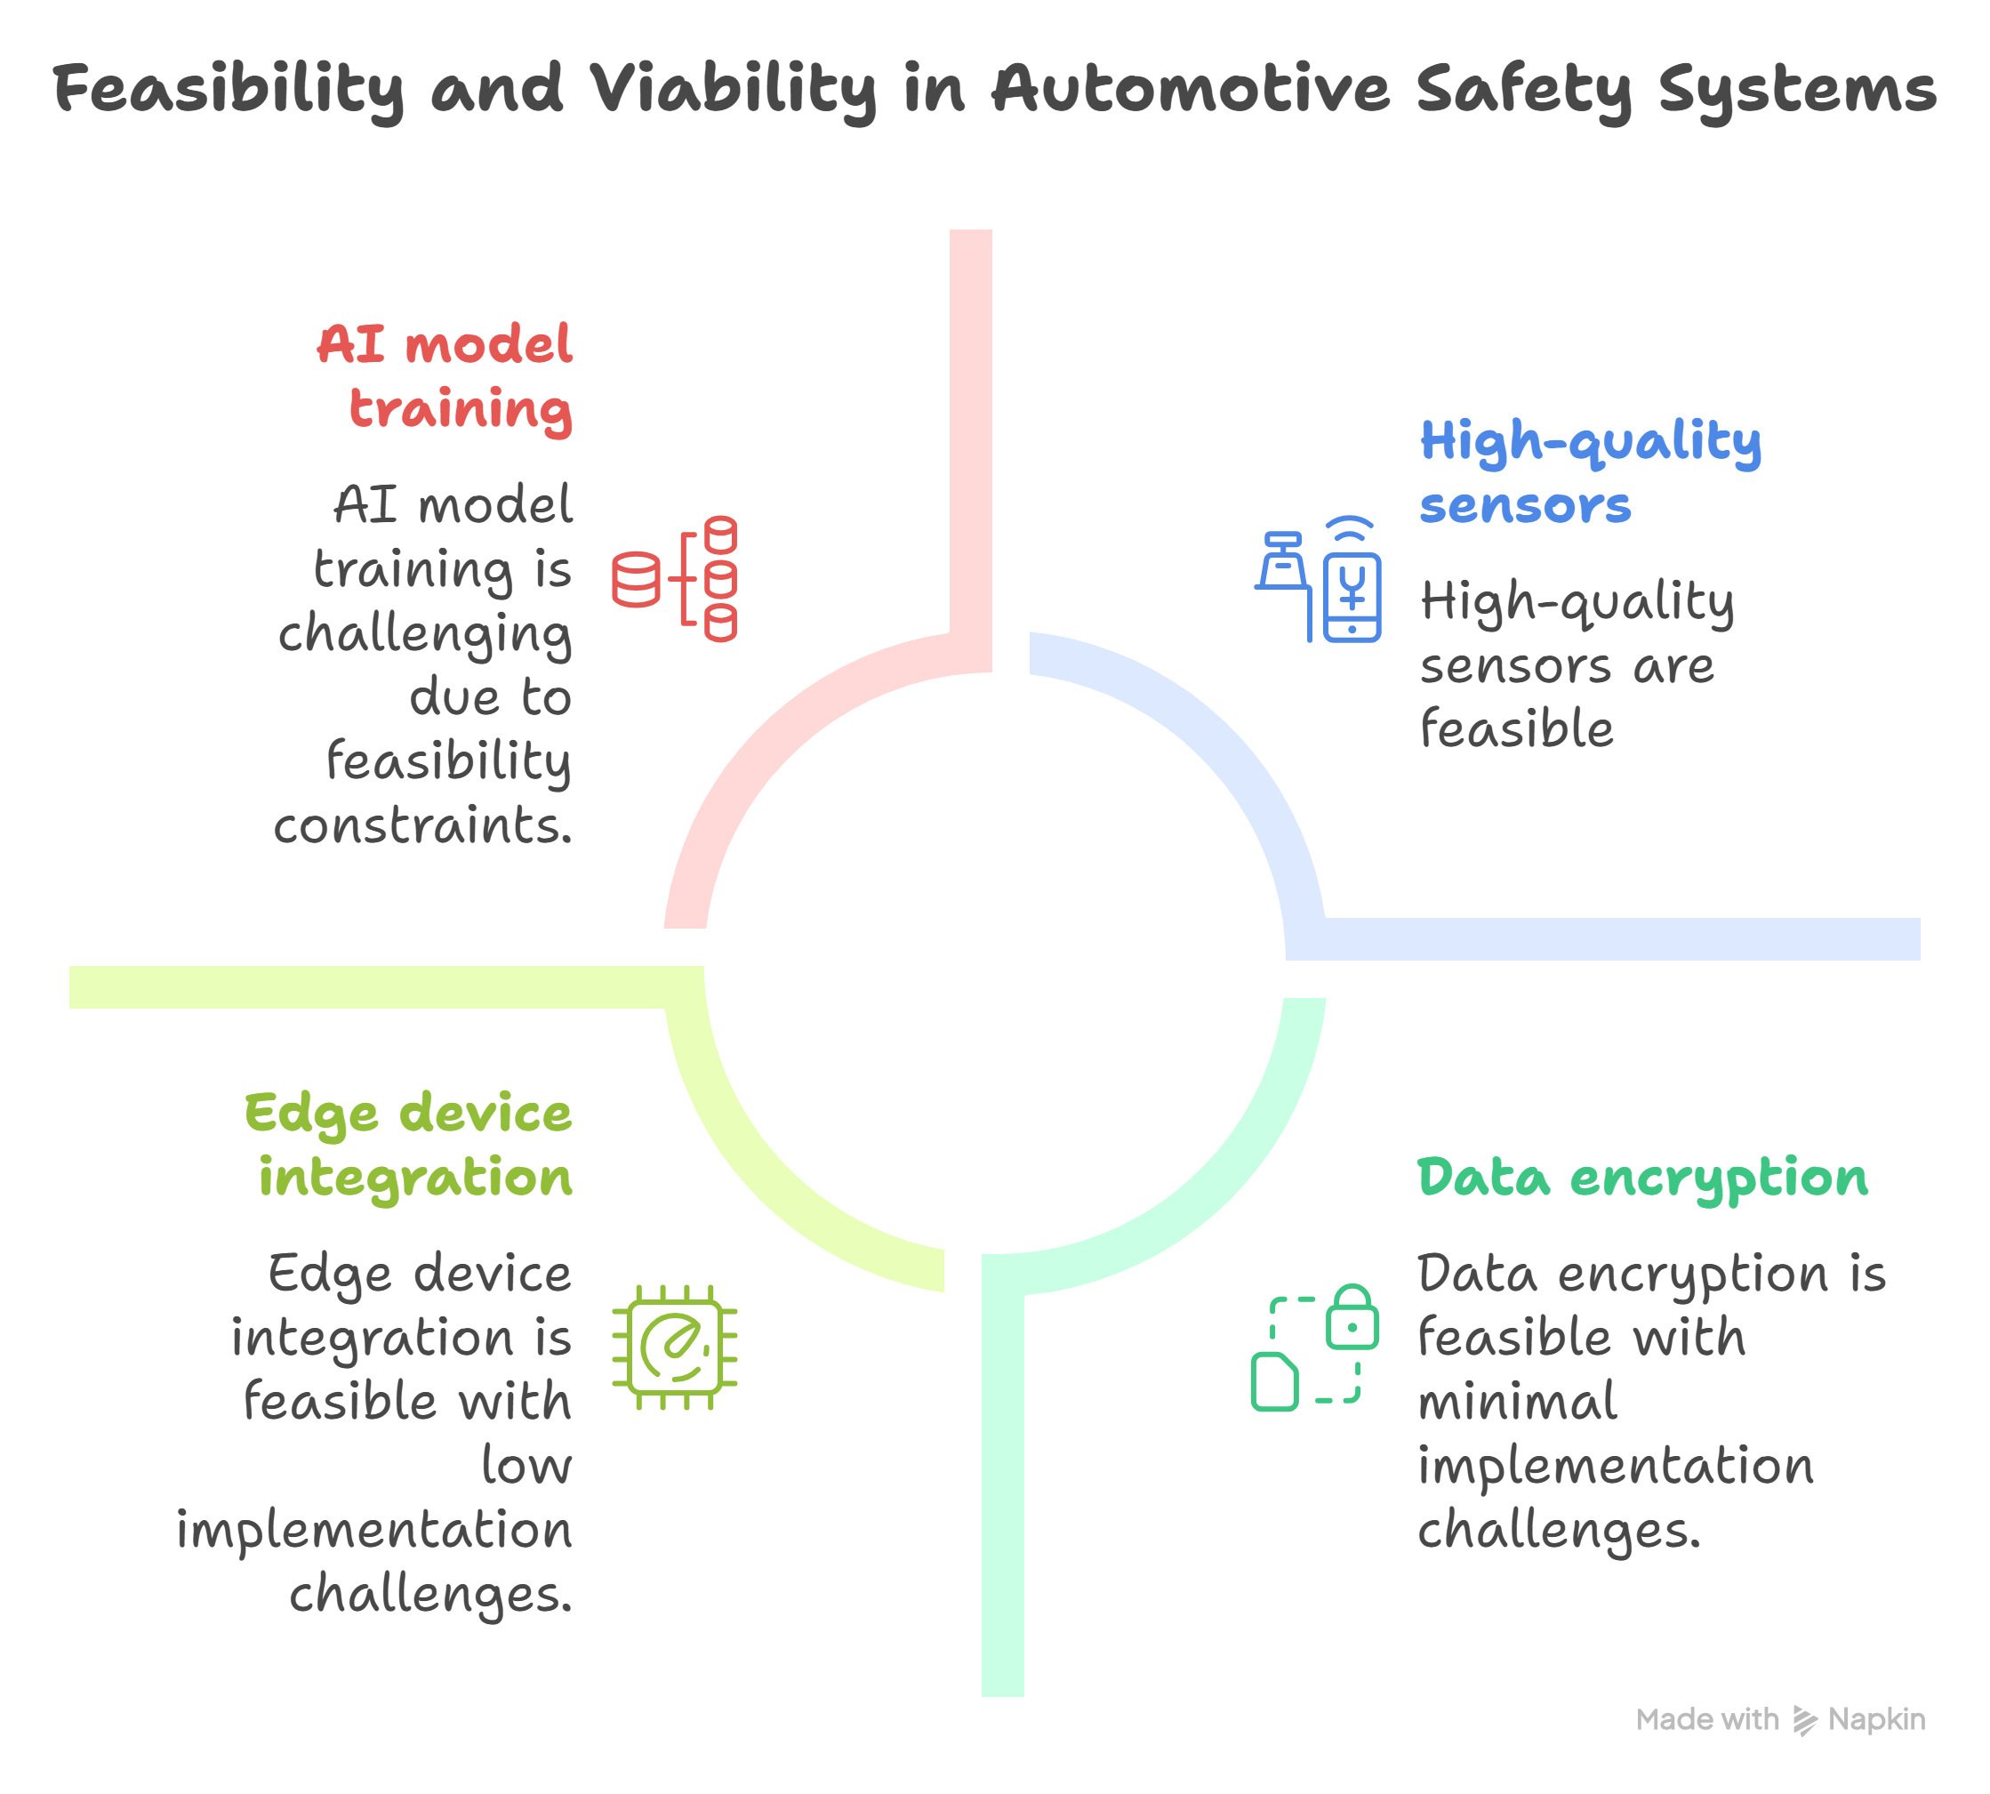
FEASIBILITY AND VIABILITY
PRAVARTAKA
This project is highly feasible due to easy sensor integration, efficient ML, and high market demand.
Key challenges are ensuring sensor reliability with a loose grip and balancing accuracy to avoid false alarms while catching every real emergency.
Solutions include using high-quality sensors, diverse ML training, data encryption, and an integrated, standardized emergency response system.

Slide 4
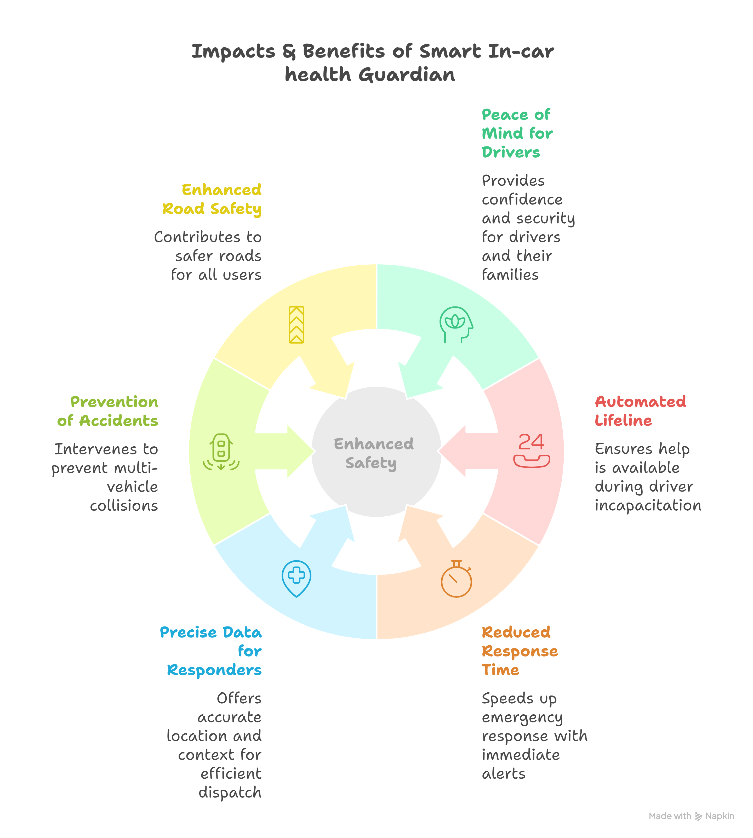
IMPACT AND BENEFITS
PRAVARTAKA
This technology offers true peace of mind for your family.
If a medical emergency happens on the road, leaving a driver unable to call, it acts as their silent guardian.
It instantly alerts responders with a precise location, turning a moment of helplessness into a story of survival and letting you worry less.

Slide 5
RESEARCH AND REFERENCES
PRAVARTAKA
Details / Links of the reference and research work:
https://docs.google.com/document/d/1OKEcv683cyiB9HHDHkJbd-X9zjG8TNkopHfk7uKvmY4/edit?usp=sharing
https://drive.google.com/drive/folders/1Tr7jt_LT80KB32ZSodSzcr_Ke7tvACEm?usp=sharing

